Slide 1
Taking a shot at free throws
Analytics Team:
Dipika Kumar
Robert Schroer
Isaac Winters
Chidera Nwaubi

Slide 2
Motivation & Summary
If a team has a higher free throw percentage, then they will have more wins
Can free throws can impact a team’s ability to win

Slide 3
Questions
Do teams that win more games have a higher free throw percentage?
Do other Free Throw statistics show a greater impact on a teams ability to win games?
Is there a bias in free throw attempts toward home teams?

Slide 4
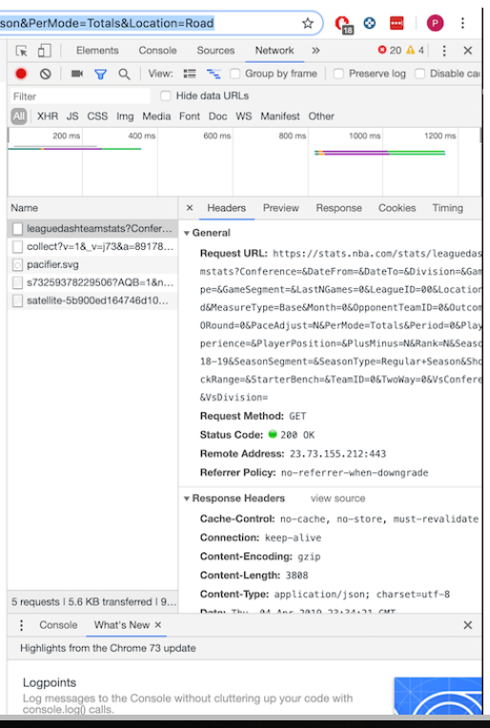
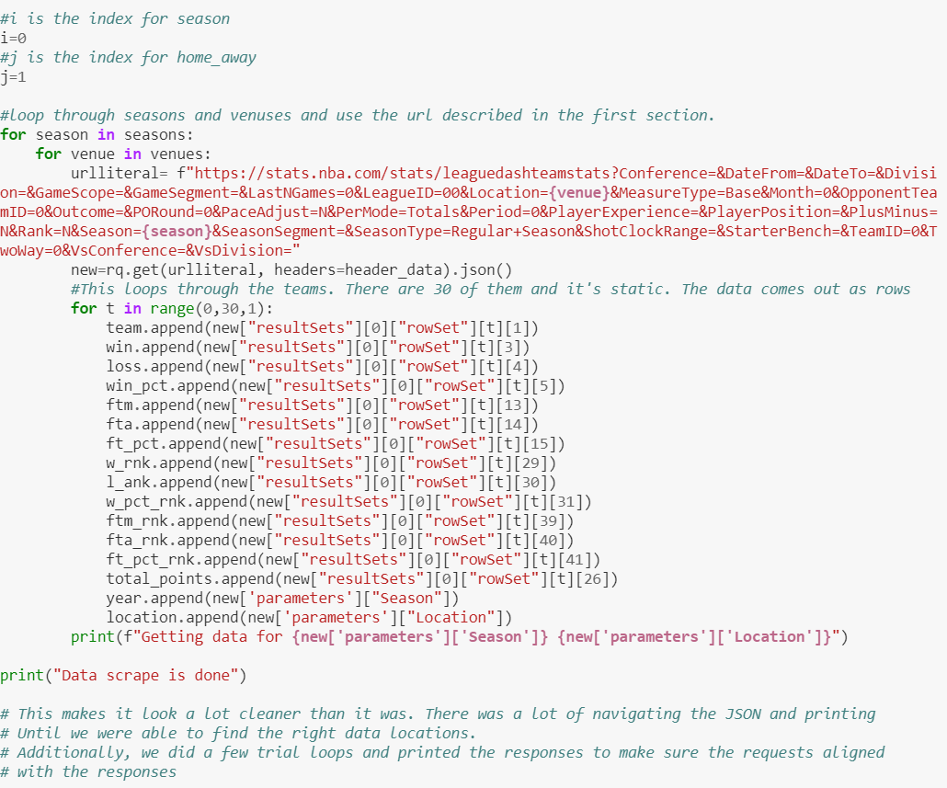
Our Data Source
Notes:
Our Data comes directly from the NBA.com Web page.
It was able to be gathered by substituting portions of the web address.
We grabbed 7 years worth of data.

Slide 5
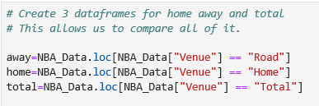
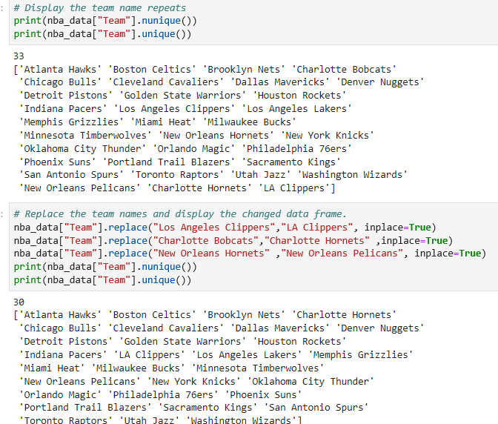
Data Clean-Up & Exploration
Game venue data
Problem discovery due to team ranks
Franchise name changes
More than 30 teams
Notes:
Problem discovery due to Team Ranks – When initially pulled the data was for home and away. While going through and starting the plots there were multiple dots on the same rank, we realized that the issue was that there was a Home Rank and an Away/Road Rank for each stat.
This was resolved by pulling in the combined rank which came in as a null value, then doing a replacement to make it Total.
Franchise Name – When running nunique count of teams in the data it came back with 33. We realized that teams had changed their names (Pelicans and Hornets) but couldn’t figure out the other one. It was a smaller change with Los Angeles Clippers now being LA Clippers.

Slide 6
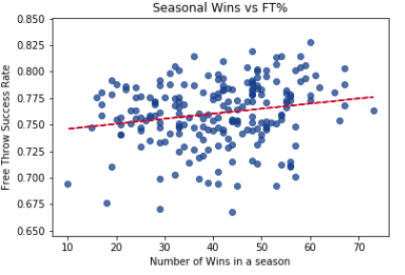
Data Analysis
Do teams with a higher free throw percentage win more games?
There is an upward trend but it is not very distinct.
Notes:
In this analysis we examined a team’s number of wins in a season in relation to a team’s free throw percentage.
There is an upward trend but it isn’t very distinct when looking at the data points. It is under fit.

Slide 7
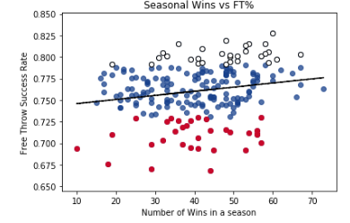
Data Analysis (Cont.)
The upper mean plus one standard deviation is White
The lower mean plus one standard deviation is Red
Notes:
Because the first graph showed an upward trend but was a bit difficult to see this one was built.
The color of the mean plus 1 standard deviation was changed to better highlight the good and bad free throw shooting teams.
This does highlight a bit better that the main grouping of high free throw percentage teams is further to the right of the chart which indicates more wins.

Slide 8
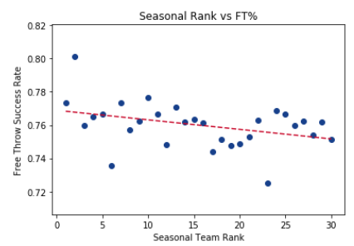
Data Analysis (Cont.)
Is there a correlation between win rankings and free throw Percentage?
Our next analysis was to explore the correlation between win rankings and free throws
Our underlying motive behind this analysis is that if teams are grouped by win rank, then the data will not necessarily follow teams, but an abstracted ranking of those teams for each year
While the previous graph appeared to show a trend, the line seemed to be underfit
We looked to see if there is a correlation between the average of the different free throw stats for each rank
I think that we can say that there is a slight trend between the two variables
Notes:
Our next analysis was to explore the correlation between win rankings and free throws
Our underlying motive behind this analysis is that if teams are grouped by win rank, then the data will not necessarily follow teams, but an abstracted ranking of those teams for each year
While the previous graph appeared to show a trend, the line seemed to be underfit
We looked to see if there is a correlation between the average of the different free throw stats for each rank
I think that we can say that there is a slight trend between the two variables

Slide 9
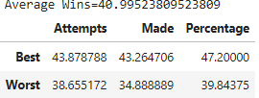
Data Analysis (Cont.)
Outside the Norm
We wanted to know which stats contributed more to wins in a season
We calculated the mean and standard deviation for the total combination of home and away games.
We found that teams were outside of the standard deviation on both ends of the spectrum.
Then, we compared the average of those populations with an average of the total population.
This is important because these relationships may not be linear and if we want to be best (or worst), then we'll want to see which factor contributes most on the edges.

Slide 10
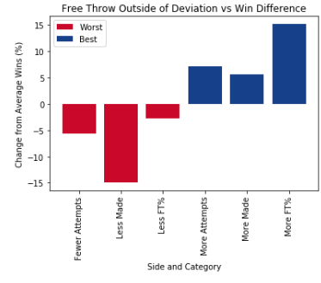
Data Analysis (Cont.)
what contributes more?
We were curious as to what factor contributed more to the best teams and the worst teams.
It looks like percentages matter more for the best, but didn't matter as much for the worst.

Slide 11
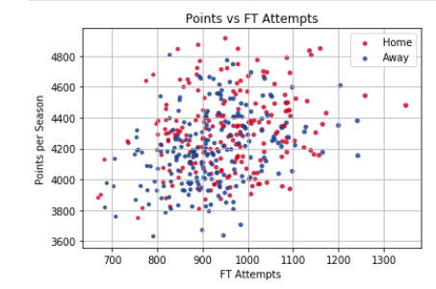
Data Analysis (Cont.)
More Free Throws Shot at Home or Away?
We wanted to see if there was any variation in the home or away games in the data.
Any variation could indicate referee bias.
To view this, we put it all on the same graph.
There appears to be a cluster in the upper right that bears this out
We plotted Points versus FT Attempts to see if we can visualize how much free throw attempts contribute to points.
Notes:
More Free Throws Shot at Home or Away?
We wanted to see if there was any variation in the home or away games in the data.
Any variation could indicate referee bias.
To view this, we put it all on the same graph.
There appears to be a cluster in the upper right that bears this out
We plotted Points versus FT Attempts to see if we can visualize how much free throw attempts contribute to points.

Slide 12
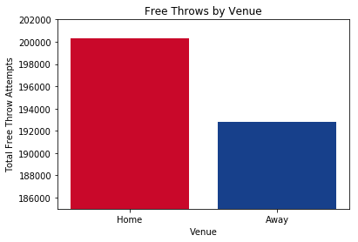
Data Analysis (Cont.)
HOME VS. AWAY
8000 attempts
Notes:
There is about an 8000 attempt difference between the home and away

Slide 13
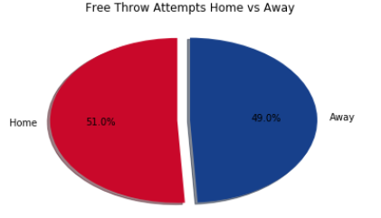
Data Analysis (Cont.)
Perception Matters
The previous graph was a bit misleading
There is a 2% difference
Yes there is an advantage, No it isn’t large
Notes:
The previous graphs were misleading
When you look holistically at the data, there is only a 2% difference in the amount of Free Throw Attempts home and away
It works out to be less than 1 more attempt per game for the home team.
Because the previous bar graph was a summation, it made the appearance of a correlation when there was none
When you look at everything, there does not appear to be a significant bias

Slide 14
Findings
Better free throw shooting teams tend to have more wins
Yes there is a home court bias but it is not a large one

Slide 15
Post Mortem: What else could be researched
Does more points equal more wins?
Obtain individual game data set
Free throw attempts home vs away based on the point differential for the game

Slide 16
Audience q&A

Slide 17


